Slide 1
Threads & Concurrency Lecture 3 Implicit Threads
David Liu
Fall 2021, Spring 2022

Slide 2
Why Implicit Threading
Threading Popularity
Explicit Threads Program Correctness Issues
Solutions:
compilers and run-time libraries

Slide 3
Current Implicit Threading Methods
Thread Pools
Fork-Join
OpenMP
Grand Central Dispatch
Intel Threading Building Blocks (TBB)

Slide 4
Thread Pools
Create a number of threads in a pool where they await work

Slide 5
Windows Thread Pools
Define function
DWORD WINAPI PoolFunction (PVOID Param) {
/*
* this function runs as a separate thread
*/
Invoke a thread for function
BOOL QueueUserWorkItem(
LPTHREAD_START_ROUTINE Function,
PVOID Context,
ULONG Flags
);

Slide 6
Windows Thread Pool
using System; //C##
using System.Threading;
public class Example {
public static void Main() {
ThreadPool.QueueUserWorkItem(ThreadProc); // Queue the task.
Console.WriteLine("Main thread does some work, then sleeps.");
Thread.Sleep(1000);
Console.WriteLine("Main thread exits.");
}
// This thread procedure performs the task.
static void ThreadProc(Object stateInfo) {
// No state object was passed to QueueUserWorkItem, so stateInfo is null.
Console.WriteLine("Hello from the thread pool.");
}
}
// The example displays output like the following:
// Main thread does some work, then sleeps.
// Hello from the thread pool.
// Main thread exits.

Slide 7
Java Thread Pools
A pool of size 1:
static ExecutorService newSingleThreadExecutor()
A thread pool of size
static ExecutorService newFixedThreadPool()
A unbounded thread pool
static ExecutorService newCachedThreadPool()

Slide 8
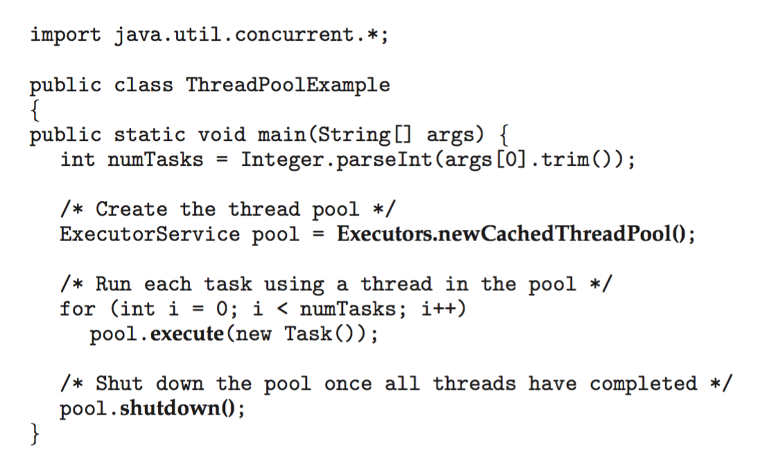
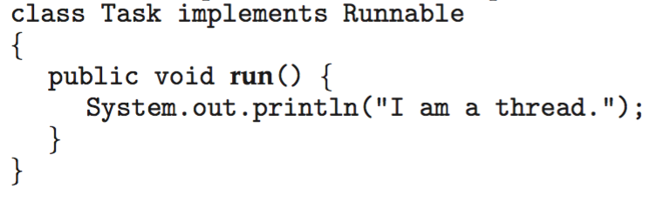
Java Thread Pool Example

Slide 9
Java Lambda Expression
How to implement Runnable task as a lambda expression?

Slide 10
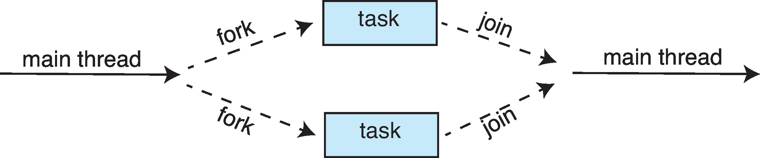
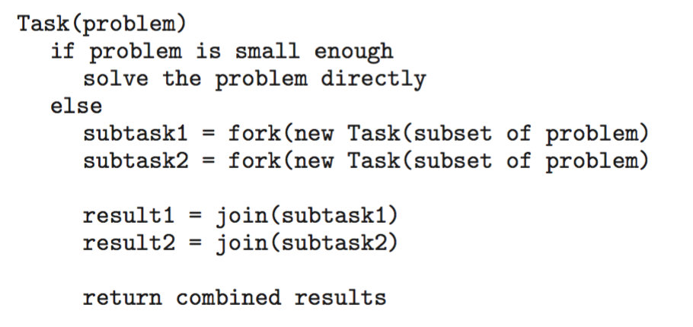
Fork-Join
Multiple threads (tasks) are forked, and then joined.
General algorithm for fork-join strategy

Slide 11
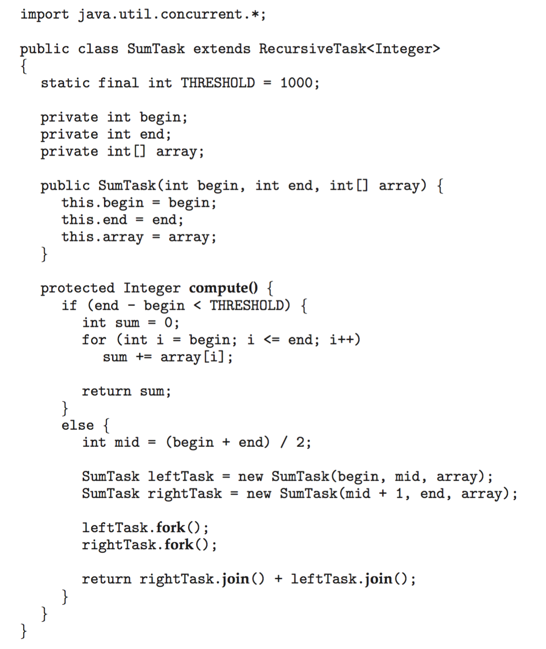
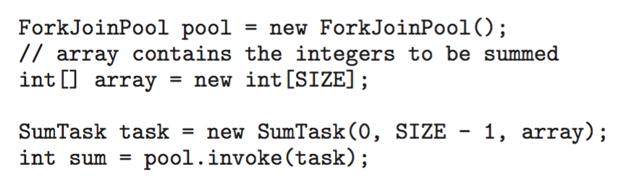
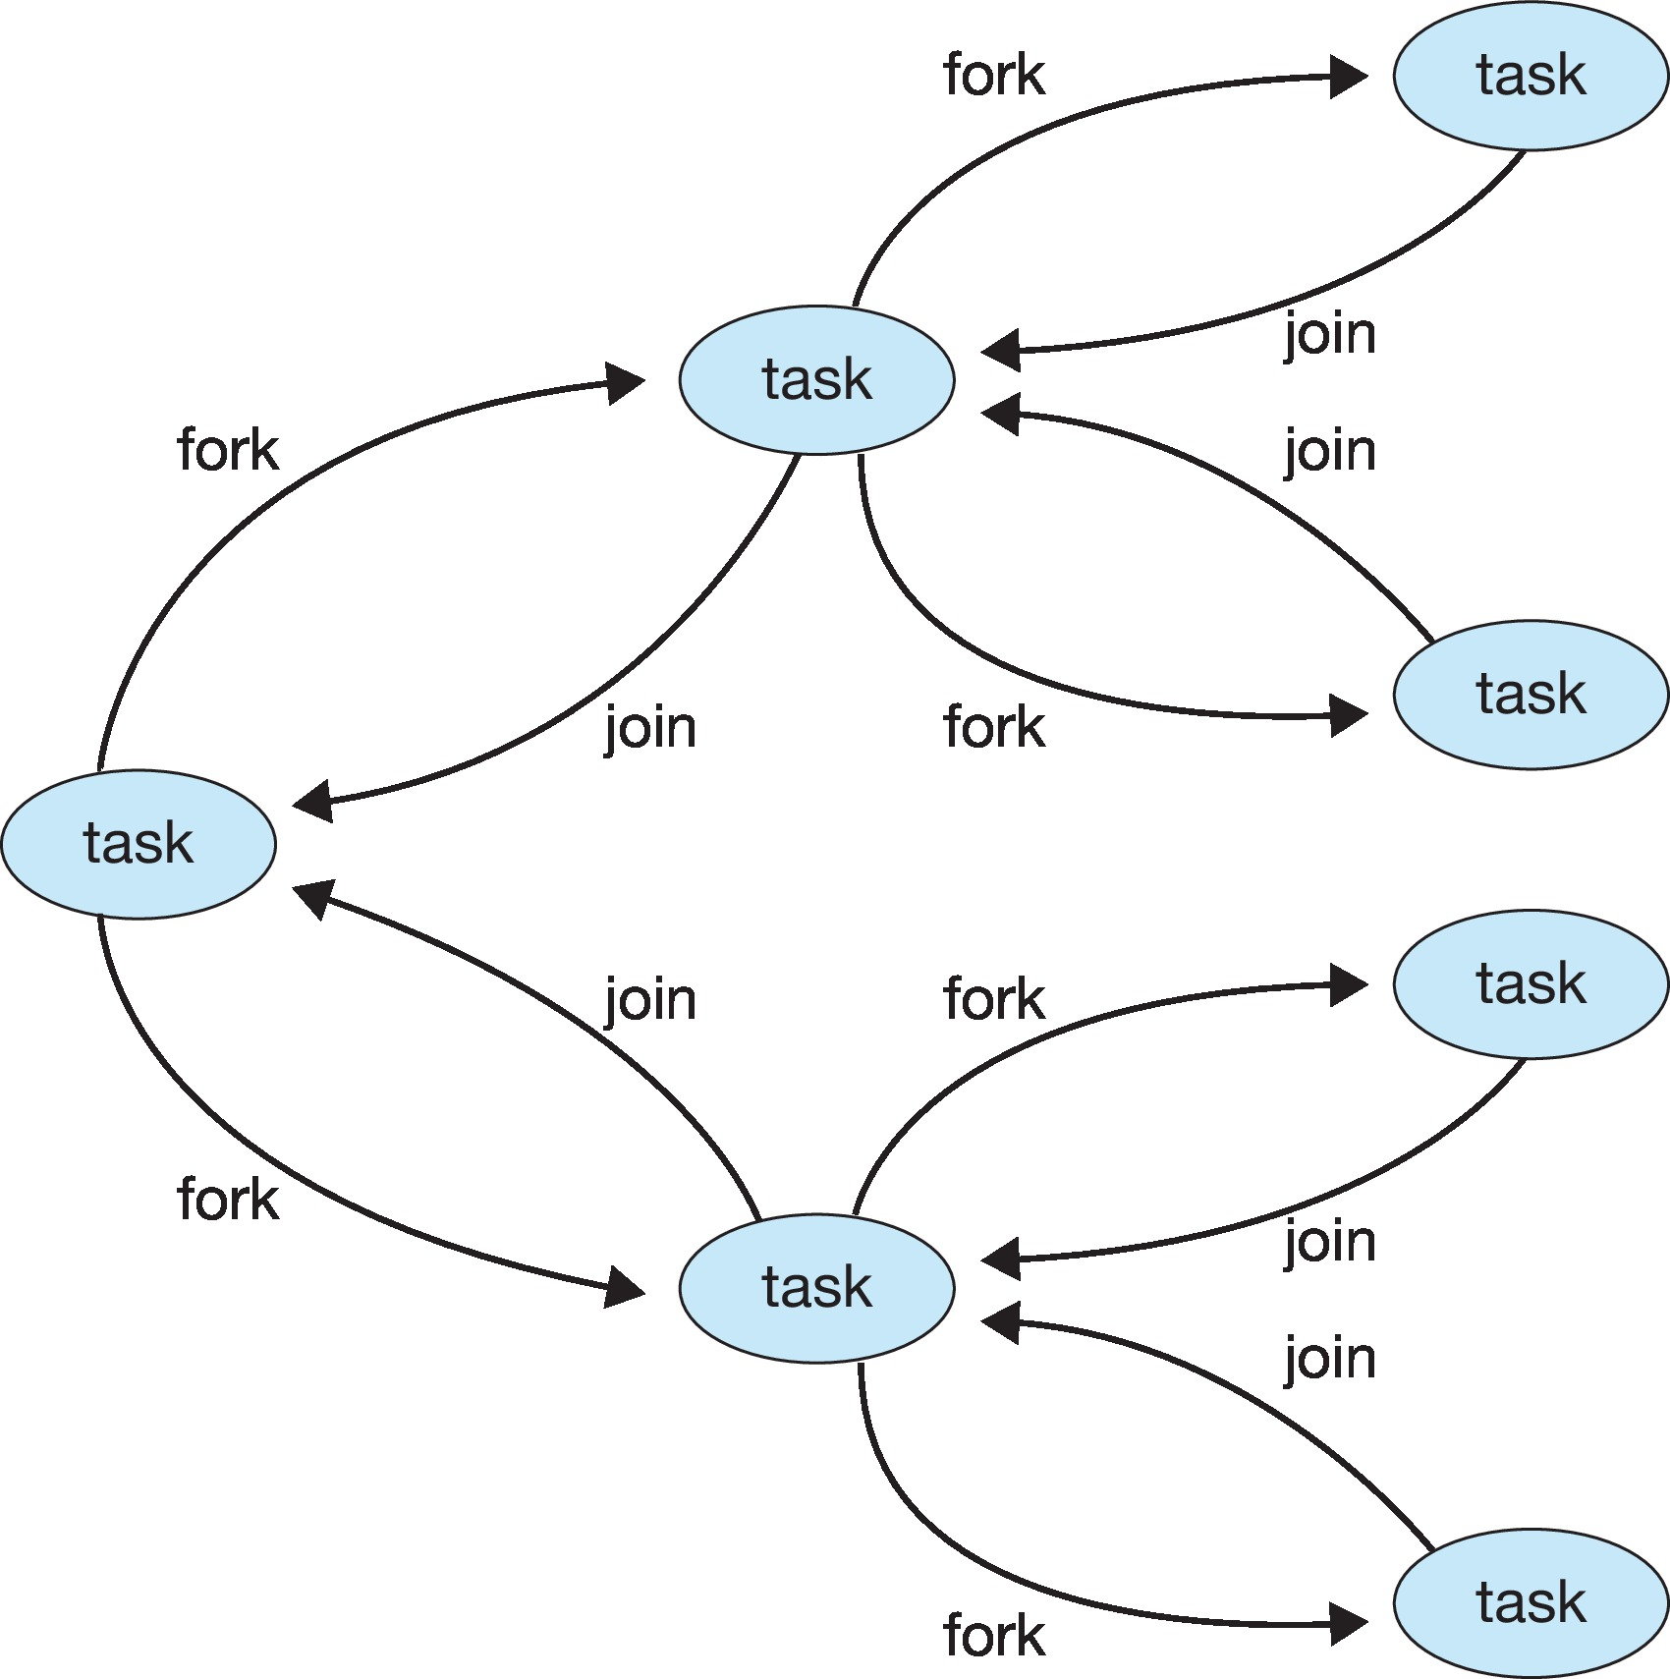
Fork-Join Java Example

Slide 12
Java Fork-Join Question
What is the difference between RecursiveTask and RecursiveAction classes?

Slide 13
OpenMP
Set of compiler directives and an API for C, C++, FORTRAN
Provides support for parallel programming in shared-memory environments
Identifies parallel regions – blocks of code that can run in parallel
#pragma omp parallel
Create as many threads as there are cores

Slide 14
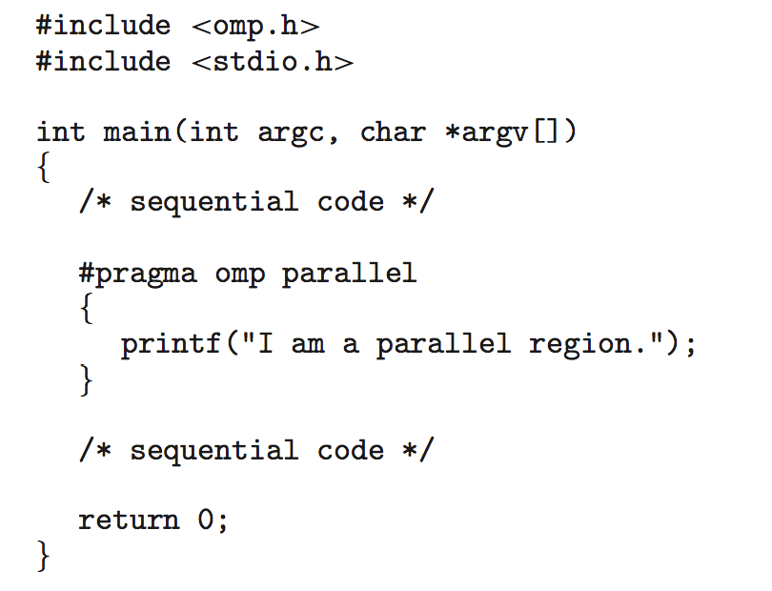
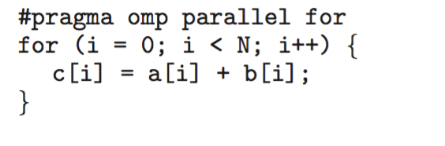
OpenMP Example
Loop in Parallel

Slide 15
OpenMP Example
Loop in Parallel
num_threads(4)
num_threads(4)

Slide 16
OpenMP
Does OpenMP support Java?

Slide 17
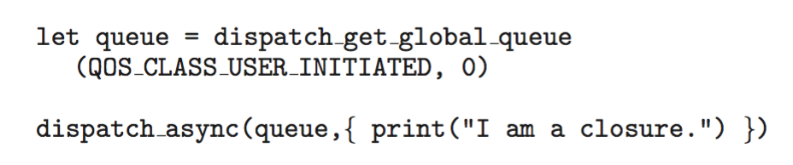
Grand Central Dispatch
Apple technology
Extensions to C, C++ and Objective-C languages, API, and run-time library
Allows identification of parallel sections
Tasks are placed in dispatch queues
Serial queue – sequential execution
Concurrent queue – multiple tasks to be execute in parallel

Slide 18
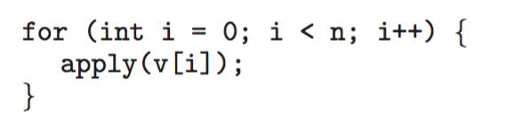
Intel TBB
Threading Building Block
Template library for designing parallel C++ programs
A serial version of a simple for loop
The same for loop written using TBB with parallel_for statement:
Lambda function

